Slide 1


http://www.comp.nus.edu.sg/~cs2100/
CS2100 Recitation 7
Boolean Algebra, Circuit Design, Simplification
10 March 2025
Aaron Tan

Slide 2


Who is this?

Slide 3
F = Σm(1,2,3,5,7)
= A’⋅B’⋅C + A’⋅B⋅C’ + A’⋅B⋅C + A⋅B’⋅C + A⋅B⋅C
A
B
C
Digital Circuits
Simplification
Boolean Algebra
A | B | C | F
0 | 0 | 0 | 0
0 | 0 | 1 | 1
0 | 1 | 0 | 1
0 | 1 | 1 | 1
1 | 0 | 0 | 0
1 | 0 | 1 | 1
1 | 1 | 0 | 0
1 | 1 | 1 | 1
F
A
B
F
C
B
F = A’⋅B’⋅C + A’⋅B⋅C’ + A’⋅B⋅C + A⋅B’⋅C + A⋅B⋅C
= C + A’⋅B
0
1
1
1
F = C + A’⋅B
A
0
1
1
0
C

Slide 4
NOT (‘)
AND (⋅)
OR (+)
0 = FALSE; 1 = TRUE
A | A'
0 | 1
1 | 0
Examples:
A ⋅ B + C = (A ⋅ B) + C
X + Y' = X + (Y')
P + Q' ⋅ R = P + ((Q') ⋅ R)
Order of precedence:
NOT > AND > OR
A | B | A ⋅ B
0 | 0 | 0
0 | 1 | 0
1 | 0 | 0
1 | 1 | 1
A | B | A + B
0 | 0 | 0
0 | 1 | 1
1 | 0 | 1
1 | 1 | 1
A
A'
Parentheses to overwrite precedence. Examples:
A ⋅ (B + C) [without parenthesis → (A⋅B)+C]
(P + Q)' ⋅ R [without parenthesis → P+((Q’)⋅R)]
A
A'
A
B
A
B
Inverter = NOT gate
A ⋅ B
A+B
NAND
NOR
A
B
(A ⋅ B)'
A
B
A | B | (A ⋅ B)'
0 | 0 | 1
0 | 1 | 1
1 | 0 | 1
1 | 1 | 0
A | B | (A + B)'
0 | 0 | 1
0 | 1 | 0
1 | 0 | 0
1 | 1 | 0
(A + B)'
A
B
(A ⋅ B)'
A
B
(A + B)'
A
B
(A ⋅ B)'
A
B
(A + B)'

Slide 5
Universal Gates
x
x'
Creating NOT, AND and OR from NAND gates.
The set {AND,OR,NOT} is a complete set of logic, ie. any Boolean function can be implemented using these 3 operations.
{NAND} is also a complete set of logic. So is {NOR}.
(x∙y)'
x
y
x∙y
x'
x
x+y
y'
y
NAND
NOR
A
B
(A ⋅ B)'
A
B
A | B | (A ⋅ B)'
0 | 0 | 1
0 | 1 | 1
1 | 0 | 1
1 | 1 | 0
A | B | (A + B)'
0 | 0 | 1
0 | 1 | 0
1 | 0 | 0
1 | 1 | 0
(A + B)'

Slide 6
XOR/XNOR Gates
Two other gates – XOR and XNOR – are useful for applications such as parity bit generation.
OR (+)
XOR (⊕)
XNOR ()
A | B | A + B
0 | 0 | 0
0 | 1 | 1
1 | 0 | 1
1 | 1 | 1
A | B | A ⊕ B
0 | 0 | 0
0 | 1 | 1
1 | 0 | 1
1 | 1 | 0
A | B | A  B
0 | 0 | 1
0 | 1 | 0
1 | 0 | 0
1 | 1 | 1
A
B
A
B
A
B
A+B
A ⊕ B
A  B

Slide 7

AND (⋅)
A | B | A ⋅ B
0 | 0 | 0
0 | 1 | 0
1 | 0 | 0
1 | 1 | 1
A
B
A ⋅ B
For AND operations, must include the AND operator ∙ (instead of omitting it)
Example: Write A∙B instead of just AB
Why? Writing AB could mean that it is a 2-bit value.

Slide 8
Laws/theorems of Boolean Algebra (CS2100)
Identity laws
A+0 = 0+A = A | A⋅1 = 1⋅A = A
Inverse/complement laws
A+A' = A'+A = 1 | A⋅A' = A'⋅A = 0
Commutative laws
A+B = B+A | A⋅B = B⋅A
Associative laws
A+B+C = A+(B+C) = (A+B)+C | A⋅B⋅C = A⋅(B⋅C) = (A⋅B)⋅C
Distributive laws
A⋅(B+C) = (A⋅B) + (A⋅C) | A+(B⋅C) = (A+B)⋅(A+C)
Idempotency
X+X = X | X⋅X = X
One element / Zero element
X+1 = 1+X = 1 | X⋅0 = 0⋅X = 0
Involution
( X' )' = X
Absorption 1
X+(X⋅Y) = X | X⋅(X+Y) = X
Absorption 2
X+(X’⋅Y) = X+Y | X⋅(X'+Y) = X⋅Y
DeMorgans’ (can be generalised to > 2 variables)
(X+Y)' = X'⋅Y' | (X⋅Y)' = X'+Y'
Consensus
X⋅Y + X'⋅Z + Y⋅Z = X⋅Y + X'⋅Z | (X+Y)⋅(X'+Z)⋅(Y+Z) = (X+Y)⋅(X'+Z)
Duality
Given a Boolean equality that is true, if the AND/OR operators and identity elements 0/1 in the equality are interchanged, the new equality is also true.

Slide 9
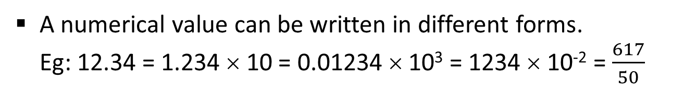
Boolean Algebra: Standard Forms
Why should we know the different forms?
A numerical value can be written in different forms. Eg: 12.34 = 1.234 × 10 = 0.01234 × 10³ = 1234 × 10⁻² = $\frac{617}{50}$
Because of their practical value.
Likewise, a Boolean expression can be written in different forms.
Eg: A Boolean function F(A,B,C) is given as A⋅B + A’⋅C + A’⋅B’
Then F(A,B,C) = A⋅B + A’⋅C + A’⋅B’ = A⋅B + B⋅C + A’⋅B’ = A⋅B + B⋅(A’+C) = A’⋅B’⋅C’ + A’⋅B’⋅C + A’⋅B⋅C + A⋅B⋅C’ + A⋅B⋅C = m0 + m1 + m3 + m6 + m7
Sum-of-products (SOP) expression
Sum-of-minterms expression
B
B
1
1
1
0
1
1
1
0
A
0
0
1
1
A
0
0
1
1
C
C

Slide 10
Definitions! (Let’s do it the CS1231S way!)
Literal
A Boolean variable on its own or in its complemented form
Examples:
x | x' | y | A'
Product term
Sum term
A single literal or a logical product (AND) of several literals
Examples:
A single literal or a logical sum (OR) of several literals
Examples:
x | x⋅y⋅z' | A'⋅B | A⋅B⋅C’ | d⋅g'⋅v⋅w
y' | x+y’+z | A+B | A’+B+C | c+d+h’+j
A
B
C
A
B
C
A⋅B⋅C’
A’+B+C

Slide 11
Definitions! (Let’s do it the CS1231S way!)
Literal
A Boolean variable on its own or in its complemented form
Product term
A single literal or a logical product (AND) of several literals
Sum term
A single literal or a logical sum (OR) of several literals
Sum-of-Products (SOP) expression
Product-of-Sums (POS) expression
A product term or a logical sum (OR) of several product terms
Examples:
A sum term or a logical product (AND) of several sum terms
Examples:
x
x + y⋅z'
x⋅y' + x'⋅y⋅z
A⋅B + A'⋅B'
A + B'⋅C + A⋅C' + C⋅D
x'
x⋅(y+z')
(x+y')⋅(x'+y+z)
(A+B)⋅(A'+B')
(A+B+C)⋅D'⋅(B'+D+E')

Slide 12

Product term
A single literal or a logical product (AND) of several literals
Sum term
A single literal or a logical sum (OR) of several literals
SOP expression
A product term or a logical sum (OR) of several product terms
POS expression
A sum term or a logical product (AND) of several sum terms
 | Expression | SOP? | POS?
(1) | A'∙B + A∙B'
(2) | (X+Y')∙(X'+Y)∙(X'+Z')
(3) | (B + D∙E)∙A∙C'
(4) | P + Q’ + R’
(5) | W∙X'∙Y'∙Z
(6) | W∙X'∙Y + V∙(X∙Z + W')
Put a tick  or cross













Slide 13
Why SOP and POS?
An SOP expression can be easily implemented using a 2-level AND-OR circuit, or a 2-level NAND circuit.
(Likewise, a POS expression can be easily implemented using a 2-level OR-AND circuit, or a 2-level NOR circuit.)
Example: F = A⋅B + C'⋅D + E
2-level AND-OR circuit
2-level NAND circuit
A
A
A
B
B
B
C
F
C
F
C
F
D
D
D
E
E
E

Slide 14
Minterms and Maxterms
A minterm of n variables is a product term that contains n literals from all the variables.
A maxterm of n variables is a sum term that contains n literals from all the variables.
Examples: On 2 variables x and y
minterms
Function F(x,y)
maxterms
x'∙y'
x'∙y
x∙y'
x∙y
= m0
= m1
= m2
= m3
M0 =
M1 =
M2 =
M3 =
x+y
x+y’
x’+y
x’+y’
In general, with n variables we have up to 2^{n} minterms and 2^{n} maxterms.
Note that mx and Mx are complement of each other (eg: m2 = M2’)

Slide 15
Minterms and Maxterms
Ability to convert minterms and maxterms from its Boolean expression to its notation (and vice versa) is important.
Test yourself with the following quiz, assuming that you are given a Boolean function F on 4 variables A, B, C, D, i.e. F(A,B,C,D).
 | Minterm | Number notation
(1) | A'∙B'∙C∙D | m3
(2) |  | m10
(3) |  | m11
(4) | A∙B∙C∙D'
(5) | A∙B'∙C'∙D
 | Maxterm | Numbernotation
(1) | A+B+C'+D' | M3
(2) |  | M13
(3) |  | M0
(4) | A+B+C'+D
(5) | A'+B+C+D'
A⋅B'⋅C⋅D'
A'+B'+C+D'
A⋅B'⋅C⋅D
A+B+C+D
m14
M2
m9
M9

Slide 16
Sum-of-minterms and Product-of-maxterms
Canonical/normal form: a unique form of representation.
Sum-of-minterms expression = Canonical sum-of-products expression
Product-of-maxterms expression = Canonical product-of-sums expression
Sum-of-minterms:
Pick minterms where the function values are 1.
x | y | z | F1 | F2 | F3
0 | 0 | 0 | 0 | 0 | 0
0 | 0 | 1 | 0 | 1 | 1
0 | 1 | 0 | 0 | 0 | 0
0 | 1 | 1 | 0 | 0 | 1
1 | 0 | 0 | 0 | 1 | 1
1 | 0 | 1 | 0 | 1 | 1
1 | 1 | 0 | 1 | 1 | 0
1 | 1 | 1 | 0 | 1 | 0
F1 = x∙y∙z' = m6
F2 = x'∙y'∙z + x∙y'∙z' + x∙y'∙z + x∙y∙z' + x∙y∙z = m1 + m4 + m5 + m6 + m7
= Σm(1,4,5,6,7) or Σm(1,4 – 7)
F3 = x'∙y'∙z + x'∙y∙z + x∙y'∙z' + x∙y'∙z = m1 + m3 + m4 + m5
= Σm(1,3,4,5) or Σm(1,3 – 5)

Slide 17
Sum-of-minterms and Product-of-maxterms
Canonical/normal form: a unique form of representation.
Sum-of-minterms expression = Canonical sum-of-products expression
Product-of-maxterms expression = Canonical product-of-sums expression
Product-of-maxterms:
Pick maxterms where the function values are 0.
x | y | z | F1 | F2 | F3
0 | 0 | 0 | 0 | 0 | 0
0 | 0 | 1 | 0 | 1 | 1
0 | 1 | 0 | 0 | 0 | 0
0 | 1 | 1 | 0 | 0 | 1
1 | 0 | 0 | 0 | 1 | 1
1 | 0 | 1 | 0 | 1 | 1
1 | 1 | 0 | 1 | 1 | 0
1 | 1 | 1 | 0 | 1 | 0
F2 = (x+y+z) ∙ (x+y'+z) ∙ (x+y'+z') = M0 ∙ M2 ∙ M3 = ΠM(0,2,3)
F3 = (x+y+z) ∙ (x+y'+z) ∙ (x'+y'+z) ∙ (x'+y'+z') = M0 ∙ M2 ∙ M6 ∙ M7 = ΠM(0,2,6,7)

Slide 18
Conversion between Sum-of-minterms and Product-of-maxterms
Very easy!
Example: Given F2(x,y,z) = Σm(1,4,5,6,7)
Product-of-maxterms expression
x | y | z | F2
0 | 0 | 0 | 0
0 | 0 | 1 | 1
0 | 1 | 0 | 0
0 | 1 | 1 | 0
1 | 0 | 0 | 1
1 | 0 | 1 | 1
1 | 1 | 0 | 1
1 | 1 | 1 | 1
F2'
1
0
1
1
0
0
0
0
F2(x,y,z) = ΠM(0,2,3)
Why?
F2' = m0 + m2 + m3 Therefore, F2 = (m0 + m2 + m3)' = m0' ∙ m2' ∙ m3' (by DeMorgan’s) = M0 ∙ M2 ∙ M3 (as mx' = Mx)

Slide 19
Boolean Algebra: Standard Forms
Why should we know the different forms?
A numerical value can be written in different forms. Eg: 12.34 = 1.234 × 10 = 0.01234 × 10³ = 1234 × 10⁻² = $\frac{617}{50}$
Because of their practical value.
Likewise, a Boolean expression can be written in different forms.
Eg: A Boolean function F(A,B,C) is given as A⋅B + A’⋅C + A’⋅B’
Then F(A,B,C) = A⋅B + A’⋅C + A’⋅B’ = A⋅B + B⋅C + A’⋅B’ = A⋅B + B⋅(A’+C) = A’⋅B’⋅C’ + A’⋅B’⋅C + A’⋅B⋅C + A⋅B⋅C’ + A⋅B⋅C = m0 + m1 + m3 + m6 + m7
Sum-of-products (SOP) expression
From an earlier slide:
Sum-of-minterms expression
= M2 ⋅ M4 ⋅ M5 = (A+B’+C) ⋅ (A’+B+C) ⋅ (A’+B+C’) = (A+B’+C) ⋅ (A’+B)
Product-of-maxterms expression
Product-of-sums (POS) expression

Slide 20
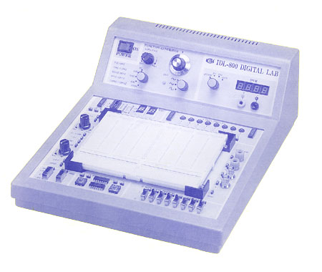
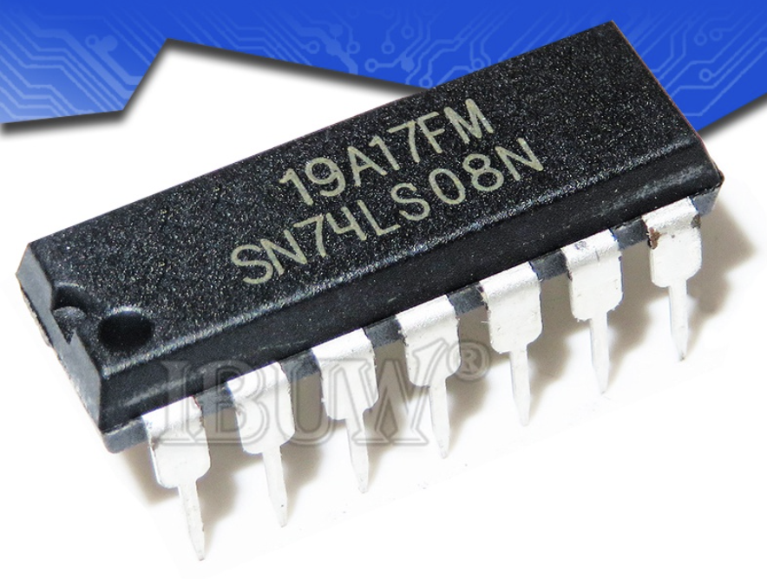
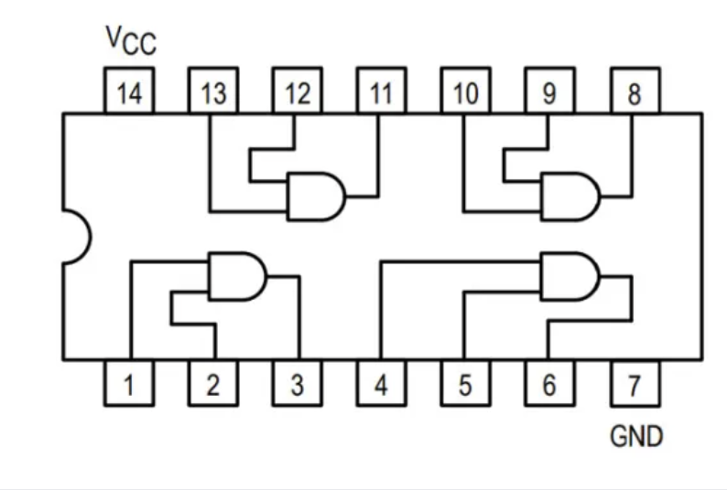
Logic Trainer Labs! Starting next week.
Comments from many past semesters’ students:
Logic trainer labs are the most fun thing about CS2100!
Lab 6: Intro to Logic Trainer
Please be punctual.
Your labTA will show you a demo.
No report submission.
Attendance 5 marks.
Logic Trainer
IC chips:
Inverter: 74LS04
2-input AND: 74LS08
2-input OR: 74LS32
2-input NAND: 74LS00
2-input NOR: 74LS02

Slide 21
Why SOP and POS?
An SOP expression can be easily implemented using a 2-level AND-OR circuit, or a 2-level NAND circuit.
(Likewise, a POS expression can be easily implemented using a 2-level OR-AND circuit, or a 2-level NOR circuit.)
Example: F = A⋅B + C'⋅D + E
Recall this earlier slide?
2-level AND-OR circuit
2-level NAND circuit
A
A
A
B
B
B
C
F
C
F
C
F
D
D
D
E
E
E

Slide 22
Programmable Array Logic (PLA)
A programmable integrated circuit – implements circuits for sum-of-products (SOP) expressions.
2 stages
AND gates = product terms
OR gates = outputs
Connections between inputs and the planes can be ‘burned’.
Inputs
AND gates
Product terms
OR gates
Outputs

Slide 23
 | Opcode
 | Op5 | Op4 | Op3 | Op2 | Op1 | Op0
R-type | 0 | 0 | 0 | 0 | 0 | 0
lw | 1 | 0 | 0 | 0 | 1 | 1
sw | 1 | 0 | 1 | 0 | 1 | 1
beq | 0 | 0 | 0 | 1 | 0 | 0
 | RegDst | ALUSrc | MemToReg | Reg Write | Mem Read | Mem Write | Branch | ALUop
 |  |  |  |  |  |  |  | op1 | op0
R-type | 1 | 0 | 0 | 1 | 0 | 0 | 0 | 1 | 0
lw | 0 | 1 | 1 | 1 | 1 | 0 | 0 | 0 | 0
sw | X | 1 | X | 0 | 0 | 1 | 0 | 0 | 0
beq | X | 0 | X | 0 | 0 | 0 | 1 | 0 | 1
Implementation of Datapath Control
Opcode
Control Signals

Slide 24
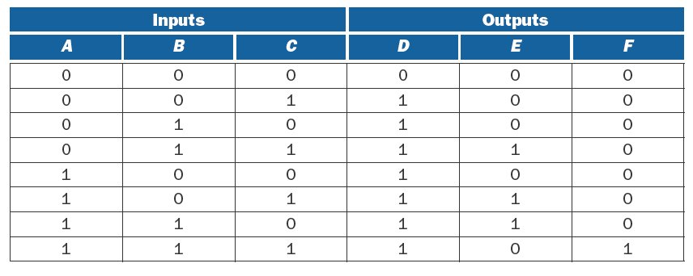
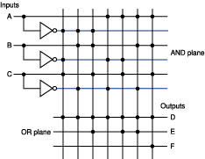
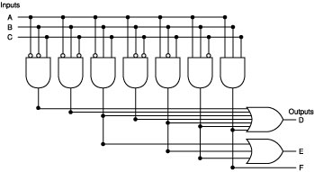
Programmable Array Logic (PLA): Example
Simplified representation
Inputs
A
A
B
B
AND plane
C
C
A'⋅B'⋅C
A'⋅B⋅C'
Outputs
D
OR plane
E
F

Slide 25
Simplification
K-Maps

Slide 26
F = Σm(1,2,3,5,7)
= A’⋅B’⋅C + A’⋅B⋅C’ + A’⋅B⋅C + A⋅B’⋅C + A⋅B⋅C
A
B
C
Digital Circuits
Simplification
Boolean Algebra
A | B | C | F
0 | 0 | 0 | 0
0 | 0 | 1 | 1
0 | 1 | 0 | 1
0 | 1 | 1 | 1
1 | 0 | 0 | 0
1 | 0 | 1 | 1
1 | 1 | 0 | 0
1 | 1 | 1 | 1
Why simplification?
F
A
B
F
C
B
F = A’⋅B’⋅C + A’⋅B⋅C’ + A’⋅B⋅C + A⋅B’⋅C + A⋅B⋅C
= C + A’⋅B
0
1
1
1
F = C + A’⋅B
A
0
1
1
0
C

Slide 27
Laws/theorems of Boolean Algebra (CS2100)
Identity laws
A+0 = 0+A = A | A⋅1 = 1⋅A = A
Inverse/complement laws
A+A' = A'+A = 1 | A⋅A' = A'⋅A = 0
Commutative laws
A+B = B+A | A⋅B = B⋅A
Associative laws
A+B+C = A+(B+C) = (A+B)+C | A⋅B⋅C = A⋅(B⋅C) = (A⋅B)⋅C
Distributive laws
A⋅(B+C) = (A⋅B) + (A⋅C) | A+(B⋅C) = (A+B)⋅(A+C)
Recall this earlier slide?
Idempotency
X+X = X | X⋅X = X
One element / Zero element
X+1 = 1+X = 1 | X⋅0 = 0⋅X = 0
Involution
( X' )' = X
Absorption 1
X+(X⋅Y) = X | X⋅(X+Y) = X
Absorption 2
X+(X’⋅Y) = X+Y | X⋅(X'+Y) = X⋅Y
DeMorgans’ (can be generalised to > 2 variables)
(X+Y)' = X'⋅Y' | (X⋅Y)' = X'+Y'
Consensus
X⋅Y + X'⋅Z + Y⋅Z = X⋅Y + X'⋅Z | (X+Y)⋅(X'+Z)⋅(Y+Z) = (X+Y)⋅(X'+Z)
Duality
Given a Boolean equality that is true, if the AND/OR operators and identity elements 0/1 in the equality are interchanged, the new equality is also true.

Slide 28
Algebraic Simplification
Example: Find the simplified SOP expression of F(a,b,c,d) = a⋅b⋅c + a⋅b⋅d + a'⋅b⋅c' + c⋅d + b⋅d'
a⋅b⋅c + a⋅b⋅d + a'⋅b⋅c' + c⋅d + b⋅d' = a⋅b⋅c + a⋅b + a'⋅b⋅c' + c⋅d + b⋅d' (absorption 2) = a⋅b⋅c + a⋅b + b⋅c' + c⋅d + b⋅d' (absorption 2) = a⋅b + b⋅c' + c⋅d + b⋅d' (absorption 1) = a⋅b + c⋅d + b⋅(c'+d') (distributivity) = a⋅b + c⋅d + b⋅(c⋅d)' (DeMorgan’s) = a⋅b + c⋅d + b (absorption 2) = b + c⋅d (absorption 1)
a⋅b⋅d + b⋅d'
= b⋅ (a⋅d + d')
= b⋅ (a + d')
= a⋅b + b⋅d'
Number of literals reduced from 13 to 3.
Absorption 1: X+X⋅Y = X
Absorption 2: X+X’⋅Y = X+Y

Slide 29
Half Adder
Half adder is a circuit that adds 2 single bits (X, Y) to produce a result of 2 bits (C, S).
The black-box representation and truth table for half adder are shown below.
X
Σ
S
In canonical form (sum-of-minterms):
C = X∙Y
S = X'∙Y + X∙Y'
Output S can be simplified further (though no longer in SOP form):
S = X'∙Y + X∙Y' = X ⊕ Y
Implementation of a half adder
Half adder
Y
C
Inputs |  | Outputs
X | Y | C | S
0 | 0 | 0 | 0
0 | 1 | 0 | 1
1 | 0 | 0 | 1
1 | 1 | 1 | 0
X
Y
S
C

Slide 30
4-Variable Karnaugh-Map (K-map)
Rows and columns in Gray code sequence (next value differs from the current value by 1 bit): eg: 00 → 01 → 11 → 10 and back to 00.
There are 2 wrap-arounds.
Every cell has 4 neighbours.
Neighbours of minterm mx are those that differ by one literals from mx.
Examples: The cell corresponding to minterm m0 has neighbours m1, m2, m4 and m8. The minterm m14 has neighbours m6, m15, m10 and m12.
y
yz
wx
00 01 11 10
00
01
11
10
m0
m1
m3
m2
m4
m5
m7
m6
x
m12
m13
m15
m14
w
m8
m9
m11
m10
z
In general, an n-variable K-map has 2^{n} cells and each minterm has n neighbours.

Slide 31
How to use K-maps
Unifying Theorem
(complement law)
A’ + A = 1
Two minterms that differ by one literal can be merged into a product term.
Eg: 4 variables A,B,C,D
m10 + m14 = A⋅B’⋅C⋅D’ + A⋅B⋅C⋅D’ = A⋅(B’+B) ⋅C⋅D’ = A⋅C⋅D’
m2 + m3 + m10 + m11 = A’⋅B’⋅C⋅D’ + A’⋅B’⋅C⋅D + A⋅B’⋅C⋅D’ + A⋅B’⋅C⋅D = A’⋅B’⋅C⋅(D’+D) + A⋅B’⋅C⋅(D’+D) = A’⋅B’⋅C + A⋅B’⋅C = (A’+A)⋅B’⋅C = B’⋅C
C
CD
Minterms that differ by one literal will appear as neighbours on the K-map (due to the Gray code sequence arrangement).
AB
00 01 11 10
00
01
11
10
m0
m1
m3
m2
m4
m5
m7
m6
B
m12
m13
m15
m14
A
m8
m9
m11
m10
D

Slide 32
How to use K-maps
In a K-map, each cell containing a ‘1’ corresponds to a minterm of the given function F where the output is 1.
Each valid grouping of adjacent cells containing ‘1’ then corresponds to a simpler product term of F.
A group must have size in powers of two: 1, 2, 4, 8, …
Grouping 2 adjacent cells eliminates 1 variable from the product term; grouping 4 cells eliminates 2 variables; grouping 8 cells eliminates 3 variables, and so on. In general, grouping 2^{n} cells eliminates n variables.
Group as many cells as possible
The larger the group, the shorter is the resulting product term.
Select as few groups as possible to cover all the cells (minterms) of the function
The fewer the groups, the fewer is the number of product terms in the simplified SOP expression.

Slide 33
How to use K-maps
Examples of valid and invalid groupings.
1
1
1
1
1
1
1
1
1
1
1
1
1
1
1
1
1
1
1
1
P
P
P
For illustration purpose here, unfilled cells are 0s. In practice, you need to fill in all cells with either 0 or 1 (or don’t care – we will cover that later.)
1
1
1
1
1
1
1
1
1
1
1
1
1
1
O
1
1
O

Slide 34
K-maps: Prime Implicants (PIs) and Essential PIs (EPIs)
F = A’⋅B’⋅C + A’⋅B⋅C’ + A’⋅B⋅C + A⋅B’⋅C + A⋅B⋅C
= C + A’⋅B
To get the simplest SOP expression from a K-map, you need to obtain:
Minimum number of literals per product term (i.e. the shortest product terms); and
Minimum number of product terms.
By finding all the biggest groupings (PIs) on the K-maps
By removing redundant PIs.
However, it might be hard to find the redundant PIs. Instead we identify the EPIs among the PIs.

Slide 35
K-maps: Prime Implicants (PIs) and Essential PIs (EPIs)
F(A,B,C) = A’⋅B’⋅C + A’⋅B⋅C’ + A’⋅B⋅C + A⋅B’⋅C + A⋅B⋅C
Implicants
B
A product term that could be used to cover some minterms of the function.
0
1
1
1
Implicants on this K-map: A’⋅B’⋅C, A’⋅B⋅C’, A’⋅B⋅C, A⋅B’⋅C, A⋅B⋅C, A’⋅C, A’⋅B, A⋅C, B’⋅C, B⋅C, and C.
A
0
1
1
0
C
Prime Implicants
1
1
1
1
1
1
A product term obtained by combining the largest number of neighbouring minterms.
1
1
1
O
1
1
1
P
PIs on this K-map: C and A’⋅B.
Always look for PIs on a K-map.
Not a PI.

Slide 36
K-maps: Prime Implicants (PIs) and Essential PIs (EPIs)
Essential Prime Implicants
A prime implicant that includes at least one minterm in it that is not covered by any other prime implicant.
Not EPI
1
1
1
1
1
1
1
1
1
1
1
1
Solution
1
1
1
1
EPIs

Slide 37
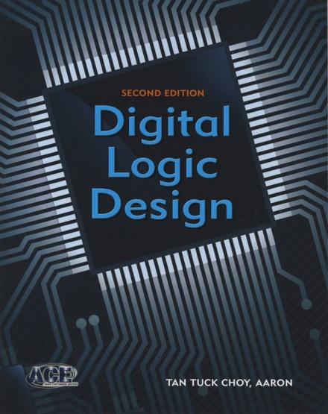
K-maps: Prime Implicants (PIs) and Essential PIs (EPIs)
DLD page 106, question 5-3.
Identify the PIs and EPIs of the K-maps below.
b
A
PIs:
EPIs:
bc
AB
a
00 01 11 10
CD
00 01 11 10
B’⋅D’

0
1
1
1
0
1
00
01
11
10
1
1
0
1
B’⋅C

0
0
1
1
A⋅B’

a
0
1
0
0
D
1
1
0
1
A’⋅C’⋅D’

c
C
A⋅C’⋅D
1
0
1
1

How many PIs?
3 PIs
A’⋅C⋅D

B
A⋅C⋅D’

How many EPIs?
2 EPIs
How many PIs?
7 PIs
How many EPIs?
4 EPIs

Slide 38
Finding simplified SOP expression on K-map
A
Algorithm
Circle all prime implicants on the K-map.
Identify and select all essential prime implicants for the cover.
Select a minimum subset of the remaining prime implicants to complete the cover, that is, to cover those minterms not covered by the essential prime implicants.
AB
Example #1:
F(A,B,C,D)
= Σ m(2,3,4,5,7,8,10,13,15)
CD
00 01 11 10
00
01
11
10
0
1
0
1
0
1
1
0
D
1
1
1
0
C
1
0
0
1
B
F = B⋅D + A’⋅B⋅C’ + A⋅B’⋅D’
+ A’⋅B’⋅C
Find PIs
6 PIs
Find EPIs
3 EPIs
Solution
A
A
A
AB
AB
AB
CD
00 01 11 10
CD
00 01 11 10
CD
00 01 11 10
00
01
11
10
0
1
0
1
00
01
11
10
0
1
0
1
00
01
11
10
0
1
0
1
0
1
1
0
0
1
1
0
0
1
1
0
D
D
D
1
1
1
0
1
1
1
0
1
1
1
0
C
C
C
1
0
0
1
1
0
0
1
1
0
0
1
B
B
B

Slide 39
Finding simplified SOP expression on K-map
Find the simplified SOP expression for G(A,B,C,D).
A
PIs:
EPIs:
AB
CD
00 01 11 10
B⋅D

00
01
11
10
0
1
0
0
A’⋅B⋅C’

0
1
1
1
D
A⋅C’⋅D

1
1
1
0
C
A’⋅C⋅D

0
0
1
0
A⋅B⋅C

B
Solution
G = A'∙B∙C' + A∙C'∙D + A'∙C∙D + A∙B∙C

Slide 40
Finding simplified POS expression on K-map
We use K-map to find the simplified SOP expression of a function. What if we want to find the simplified POS expression?
Algorithm: To find simplified POS expression of a Boolean function F
Find the simplified SOP expression of F’ on the K-map of F’.
Complement the SOP expression of F’.
Resulting expression is the simplified POS expression of F.

Slide 41
Finding simplified POS expression on K-map
Find the simplified SOP expression of F’ on the K-map of F’.
Complement the SOP expression of F’.
Resulting expression is the simplified POS expression of F.
Find the simplified POS expression of F:
F(A,B,C,D) = Σm(0,1,2,3,5,7,8,9,10,11)
Draw K-map of F’:
F’ = A⋅B + B⋅D’
K-map of F
K-map of F'
Complement both sides:
A
A
AB
AB
CD
00 01 11 10
CD
00 01 11 10
F = (A⋅B + B⋅D’)’
= (A⋅B)’ ⋅ (B⋅D’)’
= (A’+B’) ⋅ (B’+D)
00
01
11
10
1
0
0
1
00
01
11
10
0
1
1
0
1
1
0
1
0
0
1
0
D
D
1
1
0
1
0
0
1
0
C
C
1
0
0
1
0
1
1
0
B
B

Slide 42
Don’t Care Values
Datapath control
 | RegDst | ALUSrc | MemToReg | Reg Write | Mem Read | Mem Write | Branch | ALUop
 |  |  |  |  |  |  |  | op1 | op0
R-type | 1 | 0 | 0 | 1 | 0 | 0 | 0 | 1 | 0
lw | 0 | 1 | 1 | 1 | 1 | 0 | 0 | 0 | 0
sw | X | 1 | X | 0 | 0 | 1 | 0 | 0 | 0
beq | X | 0 | X | 0 | 0 | 0 | 1 | 0 | 1
In certain problems, some outputs are not specified or are invalid. Hence, these outputs can be either ‘1’ or ‘0’.
They are called don’t-care conditions, denoted by X (or d).

Slide 43
K-maps with Don’t Care Values
Example: A circuit takes in a 3-bit value ABC and outputs 2-bit value FG which is the sum of the input bits. It is also known that inputs 000 and 111 never occur.
Assuming all inputs are valid.
Assuming inputs 000 and 111 are invalid.
A | B | C | F | G
0 | 0 | 0 | 0 | 0
0 | 0 | 1 | 0 | 1
0 | 1 | 0 | 0 | 1
0 | 1 | 1 | 1 | 0
1 | 0 | 0 | 0 | 1
1 | 0 | 1 | 1 | 0
1 | 1 | 0 | 1 | 0
1 | 1 | 1 | 1 | 1
F
B
F
B
A | B | C | F | G
0 | 0 | 0 | X | X
0 | 0 | 1 | 0 | 1
0 | 1 | 0 | 0 | 1
0 | 1 | 1 | 1 | 0
1 | 0 | 0 | 0 | 1
1 | 0 | 1 | 1 | 0
1 | 1 | 0 | 1 | 0
1 | 1 | 1 | X | X
0
0
1
0
X
0
1
0
A
0
1
1
1
A
0
1
X
1
C
C
G
B
G
B
0
1
0
1
X
1
0
1
A
1
0
1
0
A
1
0
X
0
C
C
F(A,B,C) = Σm(3,5,6,7)
G(A,B,C) = Σm(1,2,4,7)
Don’t-cares could be chosen to be either ‘1’ or ‘0’, depending on which choice results in a simpler expression.
F(A,B,C) = Σm(3,5,6) + Σd(0,7)
G(A,B,C) = Σm(1,2,4) + Σd(0,7)
= A∙C + A∙B + B∙C
= A∙C + A∙B + B∙C
= A∙B'∙C' + A'∙B'∙C + A∙B∙C + A'∙B∙C'
= B'∙C' + A'∙B' + A'∙C'

Slide 44
K-maps with Don’t Care Values
Example #3 (with don’t-cares):
F(A,B,C,D) = Σm(2,8,10,15) + Σd(0,1,3,7)
Find the simplified SOP expression for F.
A
AB
CD
00 01 11 10
Solution
00
01
11
10
X
0
0
1
X
0
0
0
F(A,B,C,D) = B'⋅D' + B⋅C⋅D
D
X
X
1
0
C
0
0
1
1
B
Do we need this A’⋅B’?

Slide 45
Finding simplified POS expression with Don’t Care Values
Example #3 (with don’t-cares):
F(A,B,C,D) = Σm(2,8,10,15) + Σd(0,1,3,7)
Find the simplified POS expression for F.
F'(A,B,C,D) = Σm(4,5,6,9,11,12,13,14) + Σd(0,1,3,7)
K-map of F'
A
AB
F ' = B⋅C' + B⋅D' + B'⋅D
CD
00 01 11 10
00
01
11
10
X
1
1
0
F = (B⋅C' + B⋅D' + B'⋅D)'
= (B'+C)⋅(B'+D)⋅(B+D')
X
1
1
1
D
X
X
0
1
C
0
0
1
1
B

Slide 46
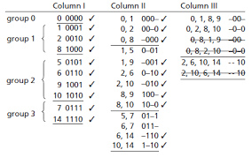
Quine McCluskey Method
K-maps are visualization form of Quine McCluskey tabulation method.
Quine McCluskey method is procedural; it works for any number of variables, and it can be programmed.
However, Quine McCluskey method is very tedious.
Lecture #16: Quine McCluskey is for optional reading. Non-examinable. But may help you understand the principle behind K-maps better.

Slide 47
QUIZZES
16: Boolean Algebra Quiz

Slide 48
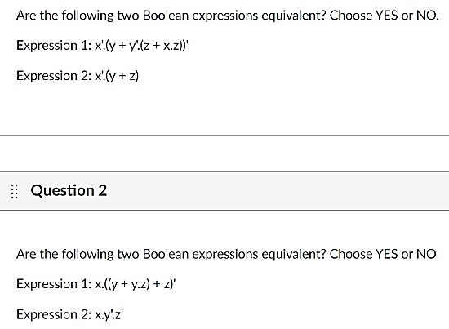
16: Boolean Algebra Quiz Q1, Q2
Q1.
Let x=0, y=0, z=0, then
x'⋅(y+z)’ = 1⋅(0+0)’ = 1
x’⋅(y+z) = 1⋅(0+0) = 0
= x'.(y+y'.z)'
= x'.(y+z)'
Absorption Theorem 1: A + A⋅B = A
NO
Absorption Theorem 2: A + A'⋅B = A + B
Q2.
= x.(y+z)'
= x.(y'.z')
Absorption Theorem 1: A + A⋅B = A
De Morgan’s Theorem: (A + B)' = A'⋅B'
YES

Slide 49
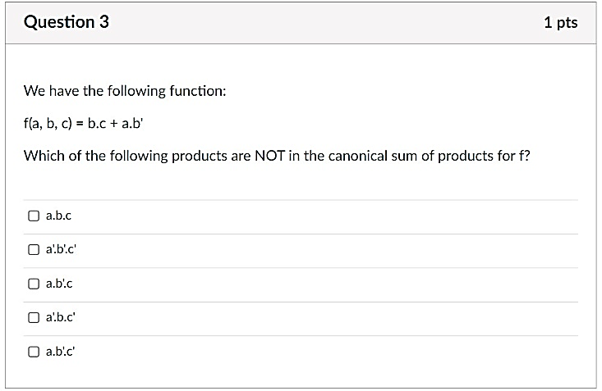
16: Boolean Algebra Quiz Q3
Canonical sum of products
= sum of minterms.
Complement law: A + A' = A' + A = 1
Identity law: A = A⋅1 = 1⋅A = A
= (a'+a).b.c + a.b'.(c'+c)
= a'.b.c + a.b.c + a.b'.c' + a.b'.c
Distributive law: A⋅(B+C) = (A⋅B) + (A⋅C)
✓
✗
✓
✗
✓

Slide 50
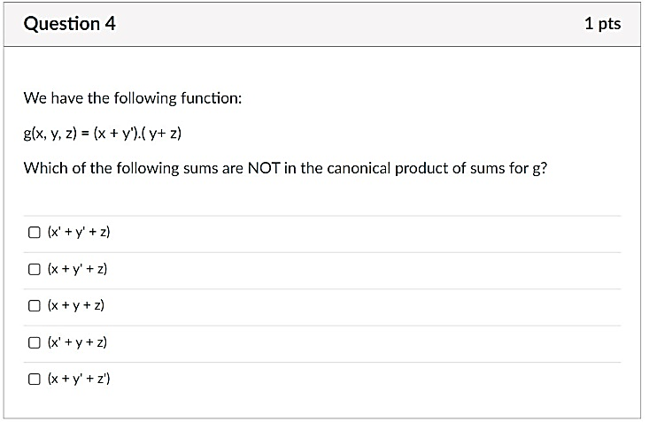
16: Boolean Algebra Quiz Q4
Canonical product of sums
= product of maxterms.
Complement law: A⋅A' = A'⋅A = 0
Identity law: A = A+0 = 0+A = A
= (x+y'+z'.z) ⋅ (x'.x+y+z)
= (x+y'+z') ⋅ (x+y'+z) ⋅ (x'+y+z) ⋅ (x+y+z)
Distributive law: A+(B⋅C) = (A+B)⋅(A+C)
✗
✓
✓
✓
✓

Slide 51
QUIZZES
17: Logic Circuit Quiz

Slide 52
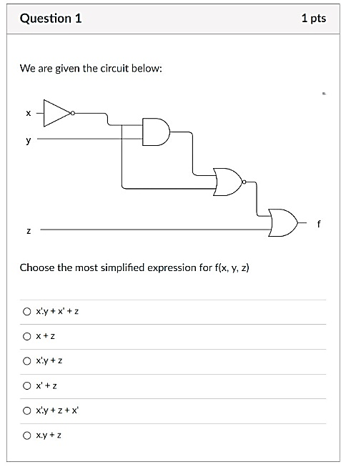
17: Logic Circuit Quiz Q1
x'
x'⋅y
((x'⋅y)+x')'
= (x'⋅y)' ⋅ x
= (x+y')⋅x
= x
✓

Slide 53
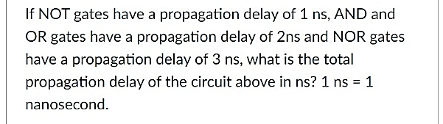
17: Logic Circuit Quiz Q2
1ns
2ns
3ns
2ns
8ns

Slide 54
QUIZZES
18: Simplification Quiz

Slide 55
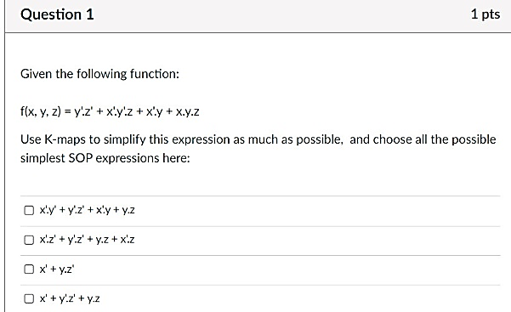
18: Simplification Quiz Q1
f
y
1
1
1
1
x
1
0
1
0
✓
z

Slide 56
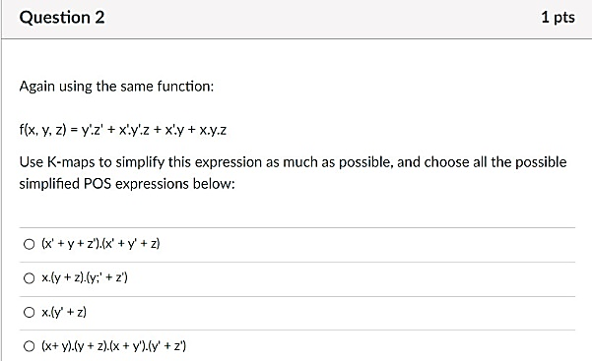
f
y
18: Simplification Quiz Q2
1
1
1
1
x
1
0
1
0
z
f'
y
✓
0
0
0
0
x
0
1
0
1
f ' = x⋅y'⋅z + x⋅y⋅z'
z
f = (x⋅y'⋅z + x⋅y⋅z')' = (x'+y+z')⋅(x'+y'+z)

Slide 57
Too few Quiz questions on K-maps.
More K-maps questions in Tutorial 6 Discussion Questions. Try them out yourself.
Reminder:
CS2100 Midterm Test on 12 March 2025, 7pm, at MPSH2B.

Slide 58
End of File

